Slide 1

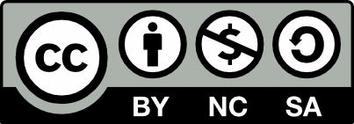

ASP.NET Pipeline
ASP.NET Pipeline
SoftUni Team
Technical Trainers
Software University
http://softuni.bg

Slide 2

Table of Contents
Controllers and the Request Pipeline
Controller Factory
Dependency Resolver

Slide 3
Have a Question?
sli.do #CSharpWeb

Slide 4
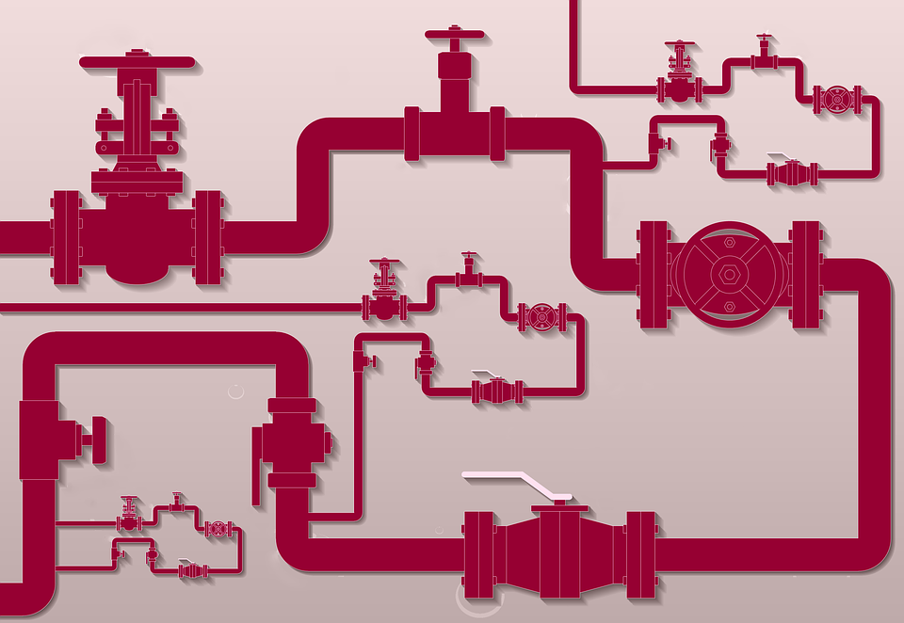
Controllers and Request Pipeline

Slide 5
Controller Concepts
Default Controller
Implementation
Views
Many powerful features
Custom Implementation
Controllers
: IController
Execute()
Just write out text
Models
Custom Implementation
Work with XML
Notes:
Controllers are the most important classes you'll work with in MVC so we really want to understand how they're created and executed. Controllers are responsible for orchestrating the relationships between Views and Models. At the low level code, however, a Controller is really nothing more than a class than implements the IController interface.
IController just defines one very important method called Execute(). This is the method that really pushes the MVC execution pipeline forward.
You could theoretically have a Controller that just writes out plain text as the response or maybe another that has some custom way of working with XML. The built-in controllers and extension points of MVC can do all of this and much more, so most of the time you'll simply be building off of the abstract Controller Base class that's already provided by MVC.

Slide 6
Controller Initialization
MVCHandler ProcessRequest()
Controller
Execution
Request
ProcessRequestInit()
Controller.Execute()
Controller Factory
Controller Activator
Dependency Resolver
Notes:
So the MVCHandler's ProcessRequest method is ultimately responsible for generating a response to an incoming request. To do this it must create and execute a controller. The MVCHandler does not complete all this work on its own through. Instead if leverages the help of a few other important classes.
First it calls a child method named ProcessRequestInit(), which asks a component called the Controller Factory to provide a Controller for the current request.
The Controller Factory selects an appropriate Controller class from the current application using the supplied route data. Remember, the Controller name is populated when the current URL is mapped to a route that we defined in our application.
Next the factory uses a component called the Controller Activator to actually create an instance of that class. The selection and instantiation of a Controller is broken into these two different steps to allow for greater extensibility and isolation of responsibility.
The Controller Activator uses a Dependency Resolver when instantiating the requested class. This is a powerful feature and it allows patterns like dependency injection to be implemented and if a Dependency Resolver cannot create an instance of that Controller, the Activator will try to do it manually.
After the MVCHandler has acquired a Controller from these steps, it calls the Execute method on that Controller. It's from within this method that all of the powerful tools like Action methods are exposed and begin processing.

Slide 7
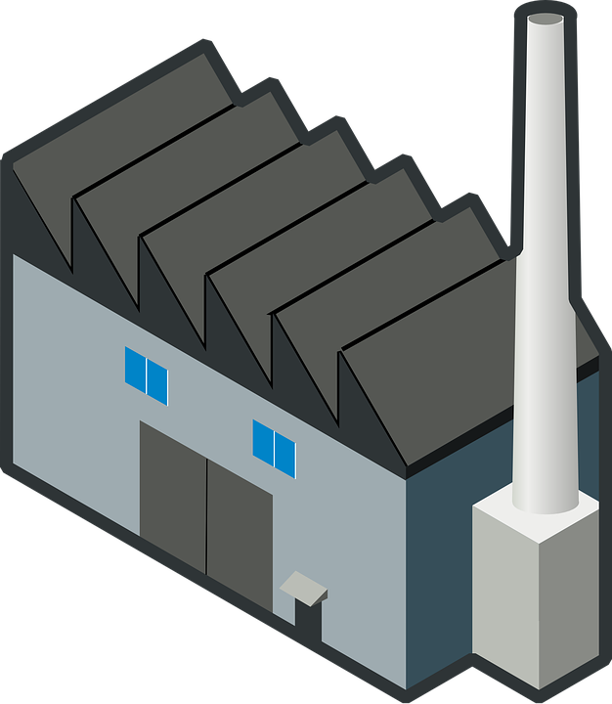
Controller Factory

Slide 8
IControllerFactory interface
public interface IControllerFactory
{
IController CreateController(
RequestContext requestContext,
string controllerName)
SessionStateBehaviour GetControllerSessionStateBehaviour()
void ReleaseController()
}
Notes:
Like many other components of MVC you can build your own Controller Factory by implementing this interface. Usually you won't be building your own Controller Factory from scratch. If you do want to add custom functionality to this component you would often inherit from the DefaultControllerFactory and just add your changes there.
IControllerFactory has three method members and on the surface it's pretty simple to implement.
– CreateController - the most important method and returns an instance of IController. Controller Factory can theoretically provide almost any type of functionality to handle a request, as long as it returns a class that implements IController.
– GetControllerSessionBehavior - determines how session is handled for the provided Controller. For example, in some cases it makes sense to have Controllers that maintain no session state at all, such as in certain performance oriented situations.
– ReleaseController - just releases any resources the factory is holding

Slide 9
Features and Conventions
Incoming URL:
Shop/Product/34
ProductsController
DefaultControllerFactory
Dependency Resolver
Notes:
DefaultControllerFactory - this class handles a lot of the low level work that we would not want to do ourselves. To begin with, it provides a nice conventions based approach to creating Controllers that just makes our lives easier. It's also very good at maintaining awareness of what Controllers are available in our application. So for example, if we request a URL with a segment called Product, the Controller Factory will extract that and build a ProductController to handle the request.
The DefaultFactory also has access to a Dependency Resolver to fetch instances of the Controller that it decides on for a given request. This is a great feature that allows for patterns like dependency injection. Many DI frameworks set a custom Dependency Resolver for your application, which can empower your Controller Factory with more robust options, like creating Controllers with parameterized constructors

Slide 10
Real World Code Implementation
CS
MvcHandler.cs
CS
DefaultControllerFactory.cs
Demo
Notes:
https://github.com/mono/aspnetwebstack/blob/master/src/System.Web.Mvc/MvcHandler.cs
https://github.com/ASP-NET-MVC/aspnetwebstack/blob/master/src/System.Web.Mvc/DefaultControllerFactory.cs

Slide 11

Controller Factory
Live Demo

Slide 12


Dependency Resolver

Slide 13
IDependencyResolver Interface
public interface IDependencyResolver
{
object GetService(Type serviceType)
IEnumerable<object> GetServices(Type serviceType)
}
Notes:
The IDependencyResolver interface exposes two methods, GetService() and GetServices(). We are especially interested in the GetService() method. This is the method that the Controller Factory uses to obtain a Controller instance to handle the response. Although the Controller Factory uses the DependencyResolver through the Activator class, we can ultimately think of GetService as the method that really instantiates our controllers.

Slide 14
Real World Code Implementation
CS
DefaultControllerFactory.cs
CS
DependencyResolver.cs
Demo
Notes:
https://github.com/ASP-NET-MVC/aspnetwebstack/blob/master/src/System.Web.Mvc/DefaultControllerFactory.cs
https://github.com/mono/aspnetwebstack/blob/master/src/System.Web.Mvc/DependencyResolver.cs

Slide 15
Dependency Resolver
Live Demo

Slide 16
Dependency Injection in WebApi

Slide 17
Ninject in Web Api
Add Ninject.Web.WebApi using nuget to your Web Api project.
To make everything work you need to add one more nuget package - Ninject.Web.Common.WebHost
This will pull down the WebActivatorEx package and add a new class called NinjectWebCommon to your App_Start directory.
Update the nuget packages.
Register some services.
Notes:
The IDependencyResolver interface exposes two methods, GetService() and GetServices(). We are especially interested in the GetService() method. This is the method that the Controller Factory uses to obtain a Controller instance to handle the response. Although the Controller Factory uses the DependencyResolver through the Activator class, we can ultimately think of GetService as the method that really instantiates our controllers.

Slide 18

Summary
MVC Handler retrieves a controller from the ControllerFactory
MVC Handler calls the Execute() method of the acquired Controller
The DefaultControllerFactory can use a Dependency Resolver to aquire controller instances
The Dependency Resolver is extensible

Slide 19

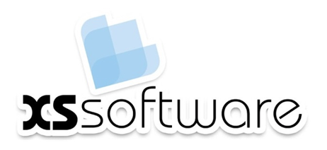
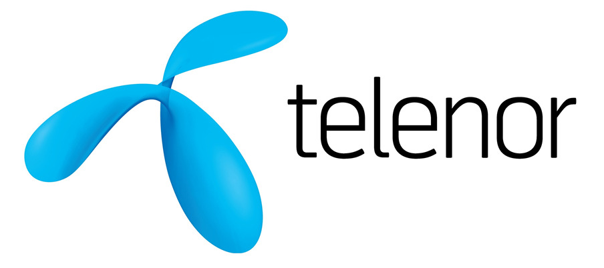





ASP.NET Web API Introduction
https://softuni.bg/courses/

Slide 20
License
This course (slides, examples, demos, videos, homework, etc.) is licensed under the "Creative Commons Attribution-NonCommercial-ShareAlike 4.0 International" license
Attribution: this work may contain portions from
"Web Services and Cloud" course by Telerik Academy under CC-BY-NC-SA license

Slide 21






Free Trainings @ Software University
Software University Foundation – softuni.org
Software University – High-Quality Education, Profession and Job for Software Developers
softuni.bg
Software University @ Facebook
facebook.com/SoftwareUniversity
Software University @ YouTube
youtube.com/SoftwareUniversity
Software University Forums – forum.softuni.bg

